Slide 1

Hospital Management System
This presentation will introduce a comprehensive Hospital Management System developed using Advanced Java Technology.
by Ahmed Shaikh

Slide 2

Project Overview
Objectives
Modules
Streamline hospital operations, improve patient care, and enhance communication between staff, patients, and administrators.
Admin, Patient, Doctor, and Appointment management functionalities.

Slide 3
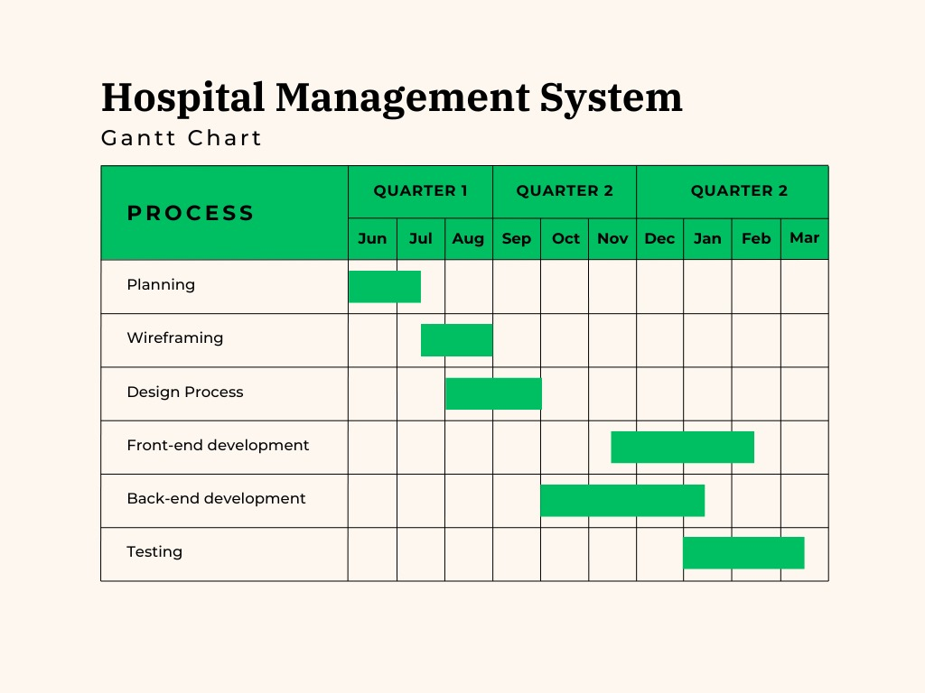
SDLC Methodology
Planning
Design
(draw.io)
Coding
(Java)
Test
Deploy
(GitHub)

Slide 4
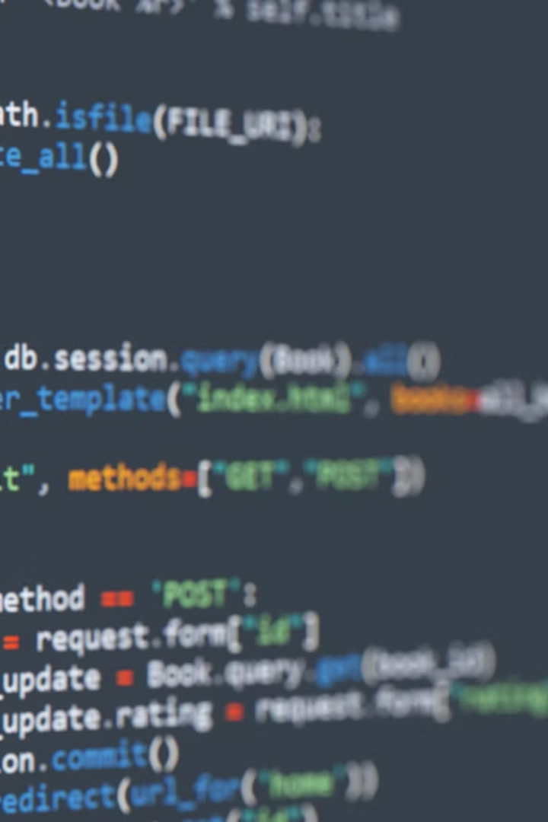



Technologies Used
Java Servlet
JDBC, MySQL
Powering the server-side logic and handling user requests.
Efficient data storage and retrieval for the hospital's information.
HTML, CSS, Bootstrap
Responsive and intuitive user interface design.

Slide 5
Tools and Framework
MVN Repo
Dependency Management
Bootstrap
Ui Elements

Slide 6
FLOW OF A CODE
Servlet
DAO
DB
Entity

Slide 7
DATABASE SCHEMA
ID PK | NAME | EMAIL | PASS
U101 | Jon | j@ | 123
U102 | Raj | r@ | 111
U103 | Noor | n@ | 888
ID PK | NAME | EMAIL | SPEC
D101 | Harry | h@ | MBBS
D102 | Priya | p@ | BDS
FK
FK
ID | USER_ ID | DOC_ ID | DATE | STATUS | PATIENT_NAME
A101 | U101 | D102 | 1/1/2025 | Pending | Jon
A102 | U102 | D101 | 5/3/2025 | ACCEPT | Raj
A103 | U103 | D102 | 5/2/2025 | REJECT | Noor
Doctor
User
Appointment

Slide 8
TEST CASES (Unit Testing)
Test Case ID | Description | Test Condition | Input Values | Expected Output | Actual Result | Remark
TC_01 | Patient Registration | Valid Input | Name: John, Email: john@example.com, Phone: 1234567890 | Successful patient registration | Patient registered successfully | Pass
TC_02 | Patient Registration | Invalid Input | Name: null, Email: invalid, Phone: 123 | Error message displayed | Error message displayed | Pass
TC_03 | Doctor Login | Valid Credentials | Email: doctor@example.com, Password: Pass@123 | Doctor logged in successfully | Login successful | Pass
TC_04 | Doctor Login | Invalid Credentials | Email: unknown@example.com, Password: wrongPass | Error message displayed | Error message displayed | Pass
TC_05 | Appointment Scheduling | Valid Input | Patient ID: 101, Doctor ID: 201, Date: 2023-12-01 | Appointment scheduled successfully | Appointment scheduled | Pass
TC_06 | Appointment Scheduling | Invalid Input | Patient ID: 0, Doctor ID:0 , Date: 2023-12-01 | Error message displayed | Error message displayed | Pass
TC_07 | Doctor Search | Valid Input | Name: "Henry" | Correct doctor details displayed | doctor details displayed | Pass
TC_08 | Doctor Search | Invalid Input | Name: "Unknown" | No doctor found | No doctor found | Pass

Slide 9








Key Functionalities
Admin
Patient
Doctor management, Payment verify.
Appointment booking, medical status.
Appointment
Doctor
Scheduling, notifications, and coordination between patients and doctors.
Patient records, appointment management.

Slide 10
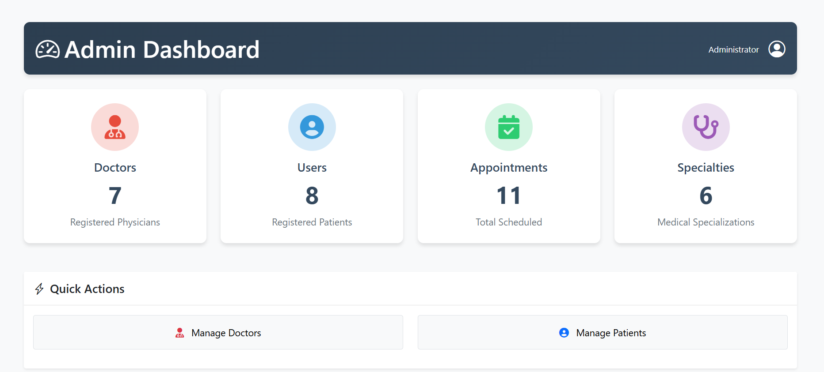
Admin Module
1
Doctor Management
2
Patient Management
3
Specialist Management
Manage DOCTOR accounts and Payments
View Patient Appointments and Payment Handling
Manage Specialties

Slide 11
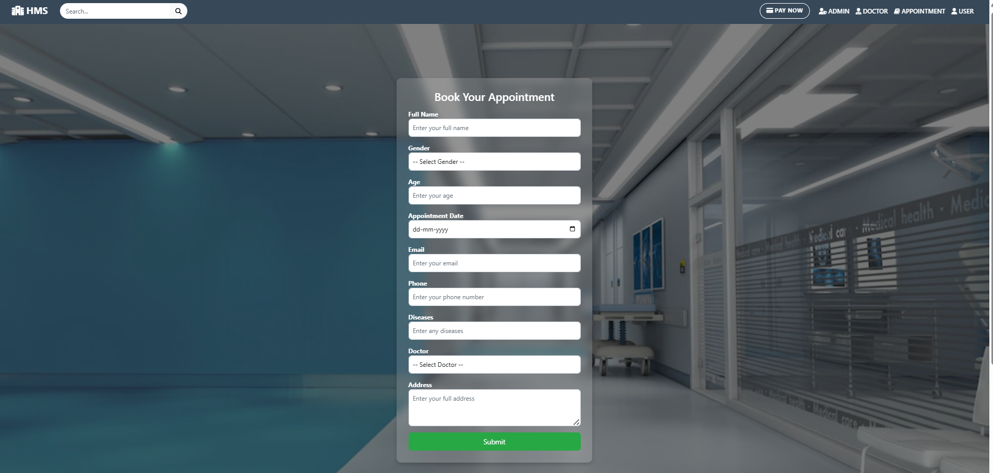
Patient Module
Appointment Booking
Medical Records Access
Patients can easily book appointments with doctors based on availability.
Patients can view and download their medical records and test results via email.
Search Doctors
Patients can search the doctors.

Slide 12
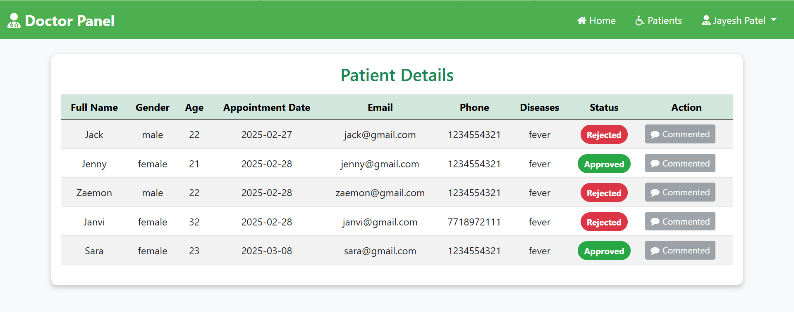



Doctor Module
Patient Records
Appointment Management
Prescription Writing
Doctors can access and update patient patients status
Doctors can view, schedule, and manage patient appointments.
Doctors can write and send prescriptions to patients and pharmacies via email.

Slide 13
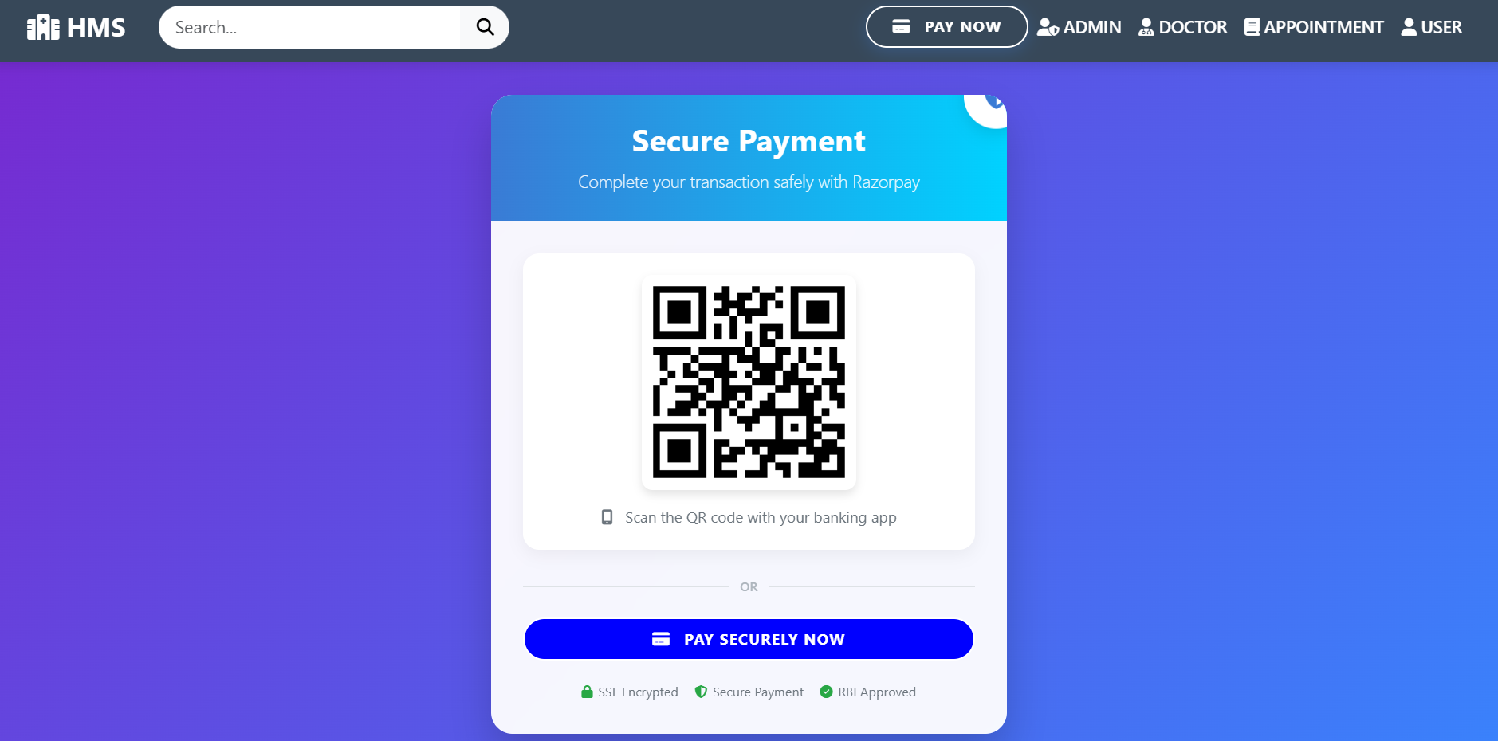
PAYMENT
Functionality:
Appointment Approved: After the doctor approves the appointment, the user sees a "Pay Now" button.
Proceed to Payment: Clicking "Pay Now" opens the Razorpay payment window.
Static Payment: The amount is fixed (static), and Razorpay handles the payment process.
Payment Confirmation: Once paid, Only the admin can view the full payment details.

Slide 14
Conclusion and Future Enhancements
Conclusion
1
The Hospital Management System streamlines hospital operations, improves patient care, and enhances communication between staff, patients, and administrators.
Future Enhancements
2
Add Dynamic Payment System , Integrate advanced analytics,
And AI-powered chatbots to further improve the system's capabilities.

Slide 15


